Slide 1
Isabelle Sourbès Verger
Senior Researcher , CNRS
Geneva UNIDIR 29/05/2019
Small satellites and small launchers,
a paradigm shift in the occupation of space?

Slide 2
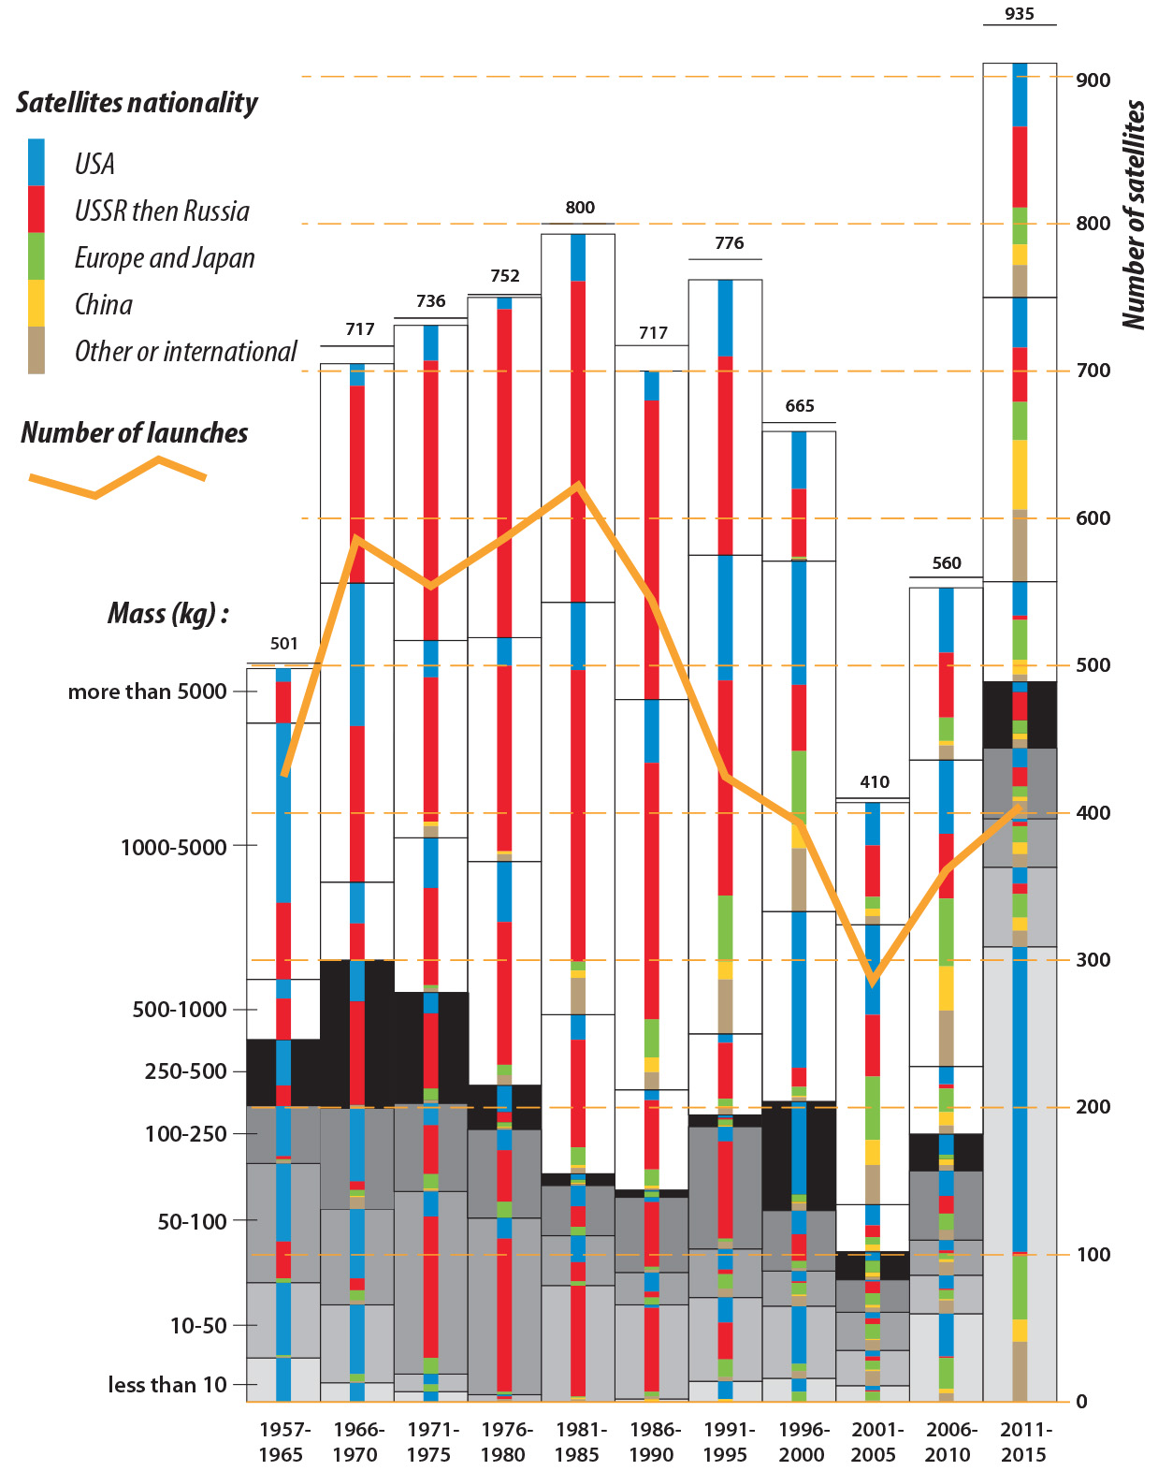
Small satellites, past and present
Definitions
mini-satellite : 100 kg - 500 kg
micro-satellite : 10 kg - 100 kg
nano-satellite : 1 kg - 10 kg
pico-satellite : 100 g - 1 kg
femto-satellite : 10 g -100 g
A shift mid 2000’
(cubesats after 2003 -> more
than 50 in 2017
An increasing number of
Small sat
2017: 455 = 2016 x2 with ¾ (319) less than 250 kg
and (284) less than 10 kg

Slide 3
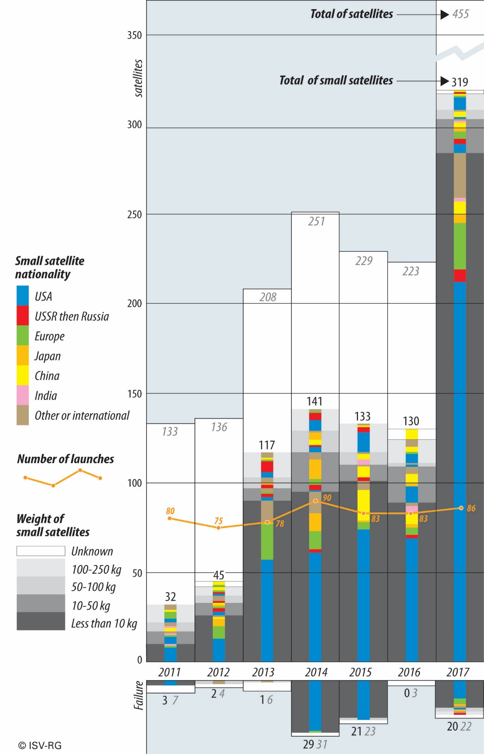
Trends of the last 8 years

Slide 4
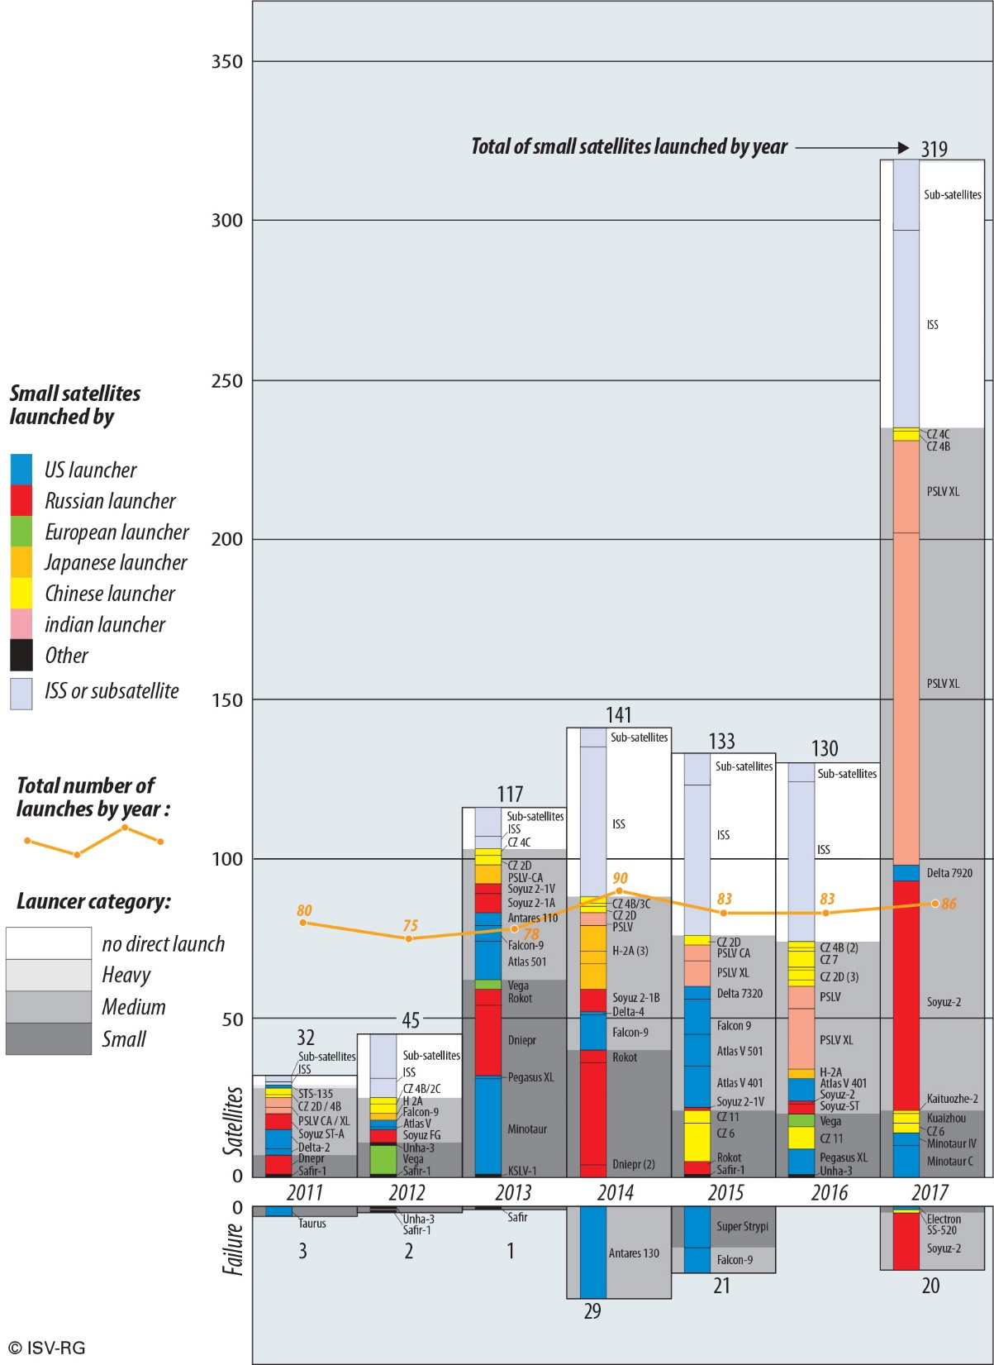
Launching opportunities

Slide 5
Small launchers
programmes

Slide 9
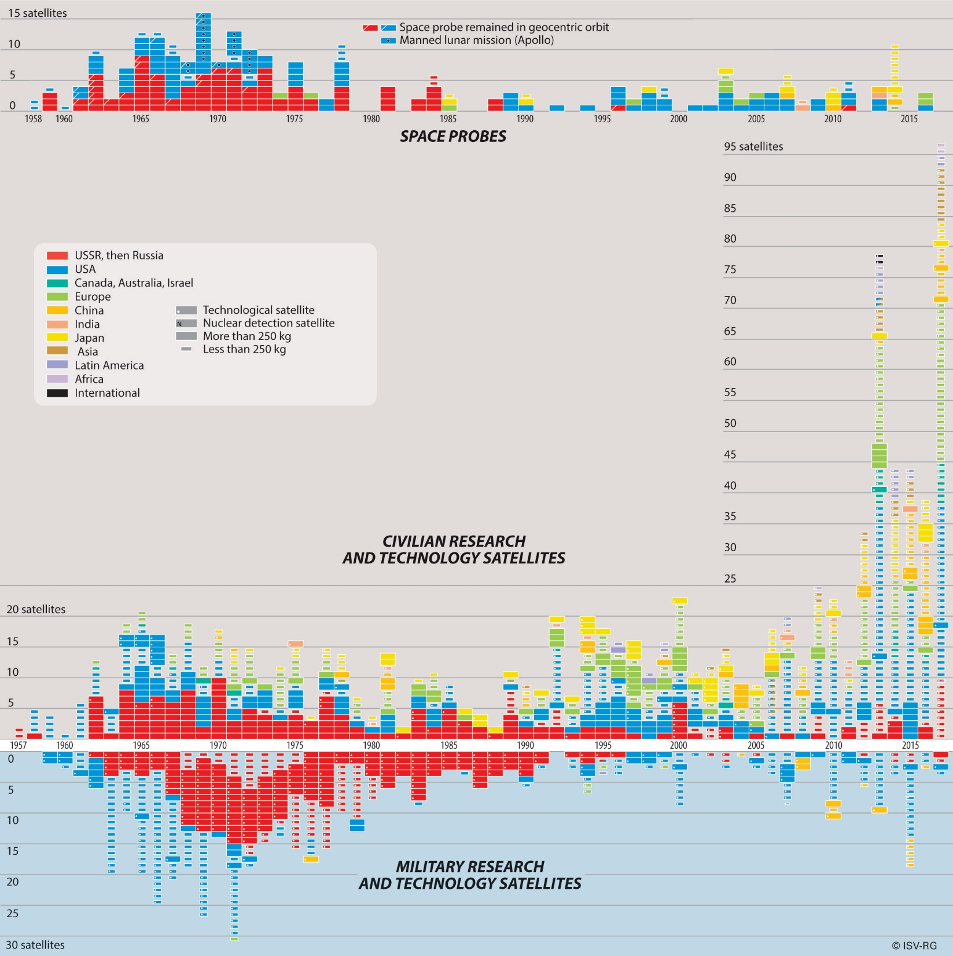

Slide 10
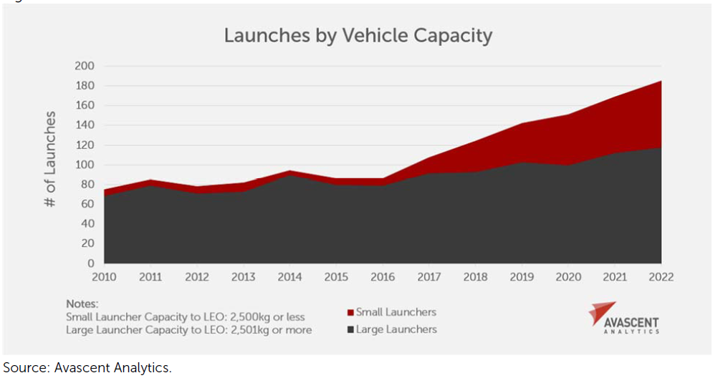
Future

